Slide 1
Maharaja Agrasen Institute of Technology
ETCS 211
Computer Graphics & Multimedia
EXPERIMENT 2
DIGITAL DIFFERENTIAL ANALYZER
CGM LAB MAIT : EXPERIMENT 2 DDA

Slide 2
Experiment – 3
Digital Differential Analyzer Algorithm
Digital differential analyzer (DDA) is used for linear interpolation of variables over an interval between given start, end points and for rasterization of lines, triangles and polygons. Using DDA Algorithm, Write a C-Program to draw a line segment between two given points?
Aim: To implement DDA Algorithm for drawing a line segment between two given end points A (x1, y1) and B(x2, y2).
Algorithm:
Start.
Declare variables x,y,x1,y1,x2,y2,k,dx,dy,s,xi,yi and also declare gdriver=DETECT, mode.
Initialize the graphic mode with the path location in TurboC3 folder.
Input the two line end-points and store the left end-points in (x1,y1).
Load (x1, y1) into the frame buffer; that is, plot the first point. put x=x1,y=y1.
Calculate dx=x2-x1 and dy=y2-y1.
If abs (dx) > abs (dy), do s=abs(dx).
Otherwise s= abs(dy).
Then xi=dx/s and yi=dy/s.
Start from k=0 and continuing till k<s,the points will be
  x=x+xi.
  Y=y+yi.
Plot pixels using putpixel at points (x,y) in specified colour.
Close Graph and stop.
CGM LAB MAIT : EXPERIMENT 2 DDA

Slide 3
Procedure-
Given-
Starting coordinates = (X₀, Y₀)
Ending coordinates = (X_{n}, Y_{n})
The points generation using DDA Algorithm involves the following steps-
Step-01:
Calculate ΔX, ΔY and M from the given input.
These parameters are calculated as-
ΔX = X_{n} – X₀
ΔY =Y_{n} – Y₀
M = ΔY / ΔX
CGM LAB MAIT : EXPERIMENT 2 DDA

Slide 4
Step-02:
Find the number of steps or points in between the starting and ending coordinates.
if (absolute (ΔX) > absolute (ΔY))
Steps = absolute (ΔX);
else
Steps = absolute (ΔY);
Step-03:
Suppose the current point is (X_{p}, Y_{p}) and the next point is (X_{p+1}, Y_{p+1}).
Find the next point by following the below three cases-
CGM LAB MAIT : EXPERIMENT 2 DDA

Slide 5
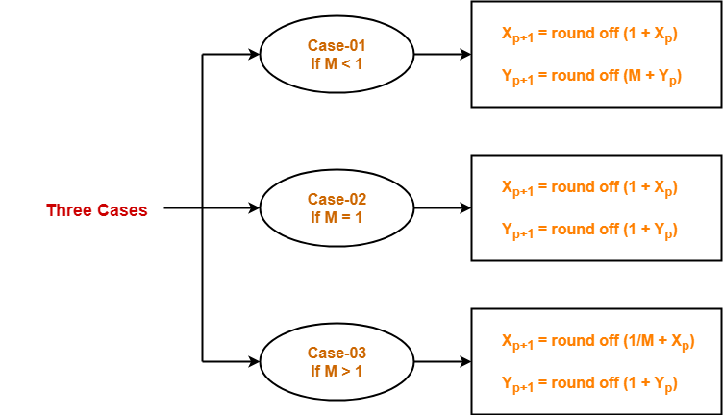
Step-04:
Keep repeating Step-03 until the end point is reached or the number of generated new points (including the starting and ending points) equals to the steps count.
CGM LAB MAIT : EXPERIMENT 2 DDA

Slide 6
Example:-
Calculate the points between the starting point (5, 6) and ending point (8, 12).
Solution-
Given-
Starting coordinates = (X₀, Y₀) = (5, 6)
Ending coordinates = (X_{n}, Y_{n}) = (8, 12)
Step-01:
Calculate ΔX, ΔY and M from the given input.
ΔX = X_{n} – X₀ = 8 – 5 = 3
ΔY =Y_{n} – Y₀ = 12 – 6 = 6
M = ΔY / ΔX = 6 / 3 = 2
Step-02:
Calculate the number of steps.
As |ΔX| < |ΔY| = 3 < 6, so number of steps = ΔY = 6
CGM LAB MAIT : EXPERIMENT 2 DDA

Slide 7
Step-03:
As M > 1, so case-03 is satisfied.
Now, Step-03 is executed until Step-04 is satisfied.
X_{p} | Y_{p} | X_{p+1} | Y_{p+1} | Round off (X_{p+1}, Y_{p+1})
5 | 6 | 5.5 | 7 | (6, 7)
 |  | 6 | 8 | (6, 8)
 |  | 6.5 | 9 | (7, 9)
 |  | 7 | 10 | (7, 10)
 |  | 7.5 | 11 | (8, 11)
 |  | 8 | 12 | (8, 12)
CGM LAB MAIT : EXPERIMENT 2 DDA

Slide 8
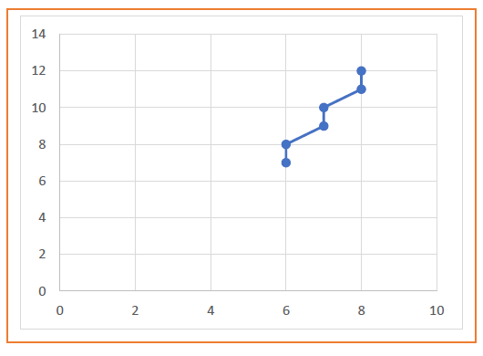
OUTPUT:-
CGM LAB MAIT : EXPERIMENT 2 DDA

Slide 9
VIVA-–VOCE QUESTIONS
Q-1.Define getpixel and putpixel functions in graphics.h?
Q-2What is the difference between DDA algorithm and
Bresenham’s Algorithm ?
Q-3. Give disadvantages of DDA algorithm?
Q-4. Give disadvantages of Bresenham’s algorithm?
CGM LAB MAIT : EXPERIMENT 2 DDA

